Slide 1
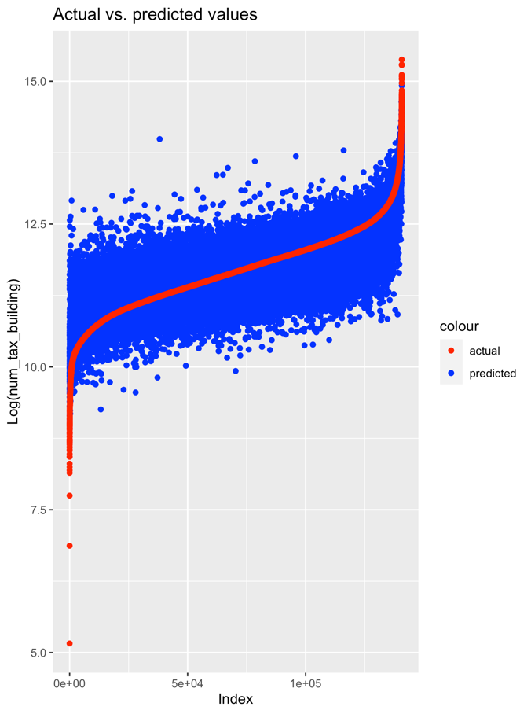
We can prove signficiant outperformance using machine learning
Executive Summary
Tim Graf – 24.02.22
XX %
Improved Prediction
(compared to presistence model)
XX £
saved¹
(compared to presistence model)
Data Cleaning
Data Cleaning
DATASET A
Power
Wind Forecast
Date & Time
 | Out-of-sample²
Method | RMSE | Adj.R2 | Improvement
Persistence | 7.4 | 0.8 | XX%
XGB – Dataset A
XGB – Dataset B
XGB – Dataset C
XGB – Dataset D
DATASET B
Power cleaned
Wind Forecast
Date & Time
DATASET C
Power
Wind Forecast
Avg, Min, Max per Month
DATASET D
Power
Wind Forecast
Avg, Min, Max per Month
Lagged Power

Slide 2
Ensemble Model shows best performance for testing data
4. Machine Learning Results
 | Root Mean Square Error |  | Adjusted R²
 | Train | Test | Train | Test | ø Prediction Error | p-value
Linear Regression | 0.4010 | 0.4001 | 0.6587 | 0.6607 | -0.00051 | 0.632
Bagging | 0.3785 | 0.3788 | 0.6963 | 0.6953 | 0.00088 | 0.385
Random Forest | 0.2688 | 0.3600 | 0.8467 | 0.7254 | -0.00345 | 0.0003 ***
XGBoost | 0.3238 | 0.3572 | 0.7776 | 0.7296 | -0.00087 | 0.358
Stacked Generalization | 0.3113 | 0.3529 | 0.7945 | 0.7361 | -0.00218 | 0.02 **
Notes:
Outperformance of testing dataset:
Linear Model underperforms any other ML Model – led by Stacked Generalization with a difference of 11.4%.
Around 10% better than Linear Regression
Difference between Train and Test:
Large with Random Forest
Prediction error
the t-test of the prediction error shows that on the 5% significance level the Null-Hypothesis of having a zero mean in the average prediction error (actual minus predicted value) can be rejected

Slide 3
What was Our Approach?
2. Methodology & Data Cleaning
Implications:
Chose Zillow Data instead of previously used AHS Survey
Thorough inspection of data (NAs, Errors, Type, etc.)
Cleaning based on inspection findings and research constraints
Modelling appropiately with remaining hedonics
Find quality data
Inspect & Clean
Model & Interpret
well-distributed housing prices (sample bias)
Some spatial component
Sufficient hedonics
‘Objective’ pricing
Number of observations
Important Hedonics?
Missing Observations?
Soundness?
Distributions?
Correlogram
Transformations
Model Specification
Training & Testing
Interpret Results

Slide 4
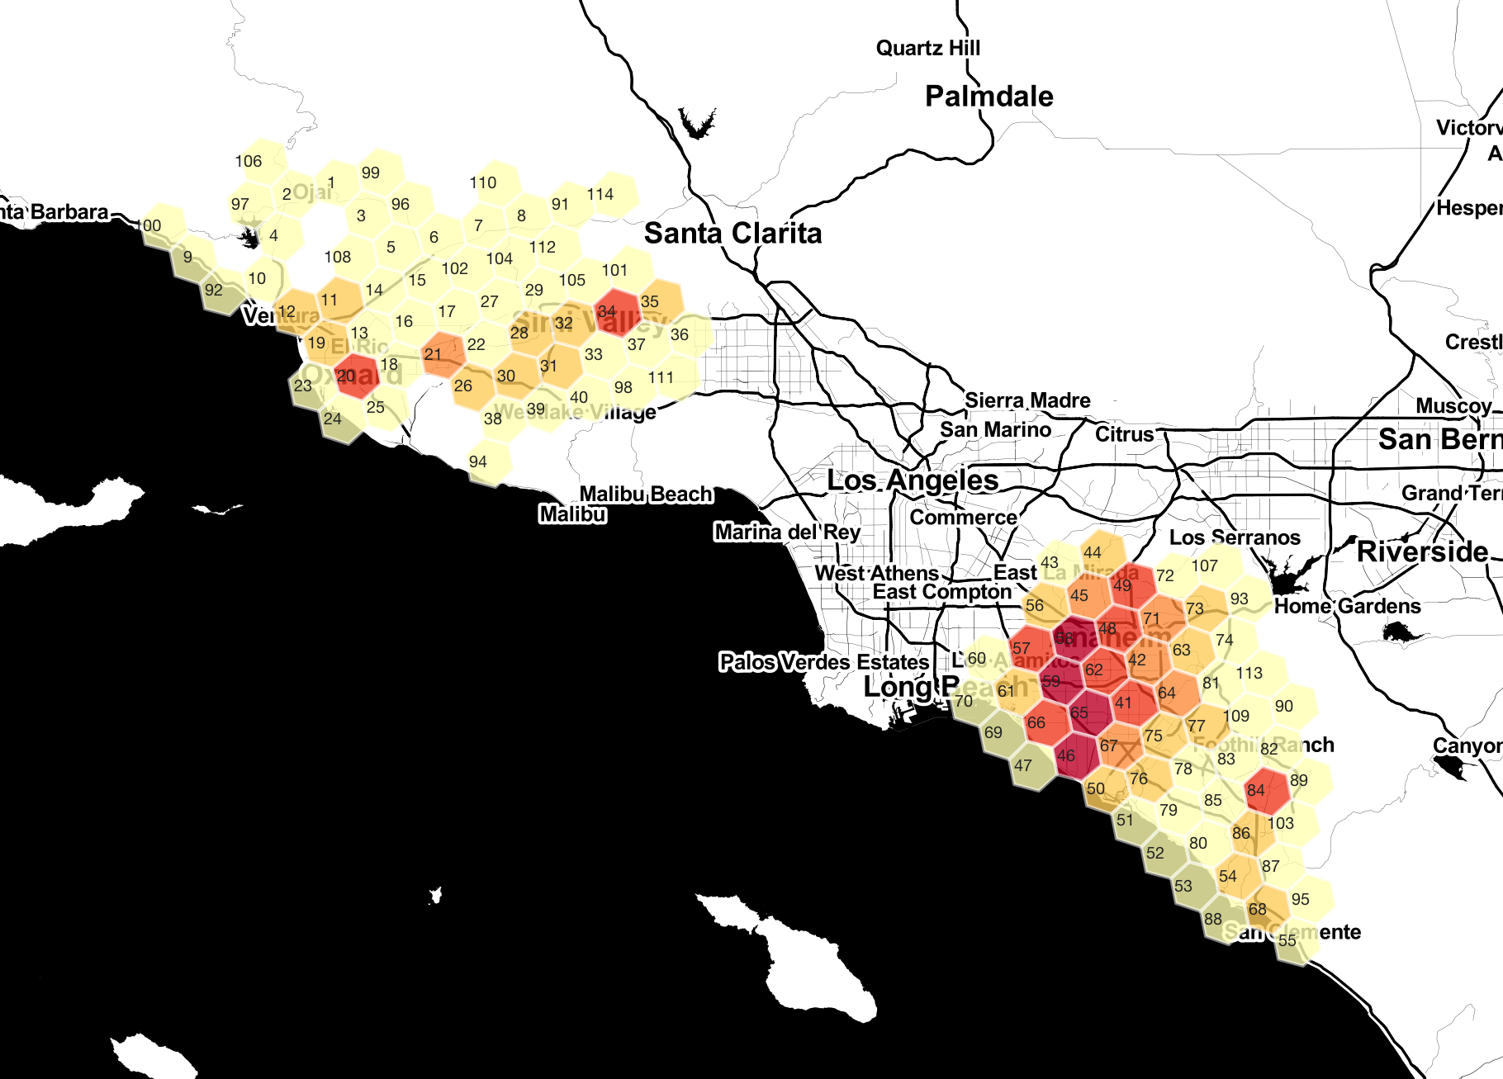

Our data contains real estate data from Los Angeles (USA)
2. Methodology & Data Cleaning
Data Provider:
Pre-Cleaning:
# Observations
# Variables
Time Frame
2’985’217
58
2016 & 2017
Post-Cleaning:
# Observations
# Variables
Time Frame
562’983
13 (incl. Long, Lat)
2016
Source: https://www.kaggle.com/c/zillow-prize-1/overview

Slide 5
How did we clean the dataset?
2. Methodology & Data Cleaning
Our aim was to ensure most observations for the following ‘Important’ Hedonics*:
Building Price (tax value)
Living Area (sqft)
Lot Area (sqft)
Garage Area (sqft)
No. Bedrooms
No. Bathrooms
No. The story
No. Garage
Area Garage (sqft)
No. pools
Fireplace
Tub or Spa
→ Single-Family Residential Homes

Slide 6
Histograms of our selected Hedonics
2. Methodology & Data Cleaning

Slide 7
Histograms of our selected Hedonics - transformed
2. Methodology & Data Cleaning

Slide 8
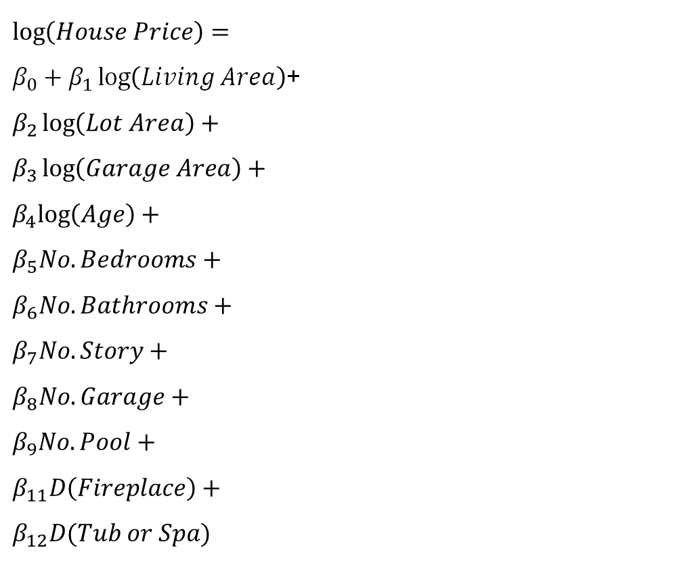
How did we specify our Hedonic Regression Model
3. Hedonic Regression
$$\log\left(House Price\right)=$$
$β_{0}+β_{1}\log\left(Living Area\right)$+
$$β_{2}\log\left(Lot Area\right)+$$
$$β_{3}\log\left(Garage Area\right)+$$
$$β_{4}log\left(Age\right)+$$
$$β_{5}No. Bedrooms+$$
$$β_{6}No. Bathrooms+$$
$$β_{7}No. Story+$$
$$β_{8}No. Garage+$$
$$β_{9}No. Pool+$$
$$β_{11}D\left(Fireplace\right)+$$
$$β_{12}D(Tub or Spa)$$
California's Proposition 13
Proposition 13 requires assessment of each taxable property based on its fair market value and limits a property owner’s general levy tax to 1 percent of the assessed value.

Slide 9
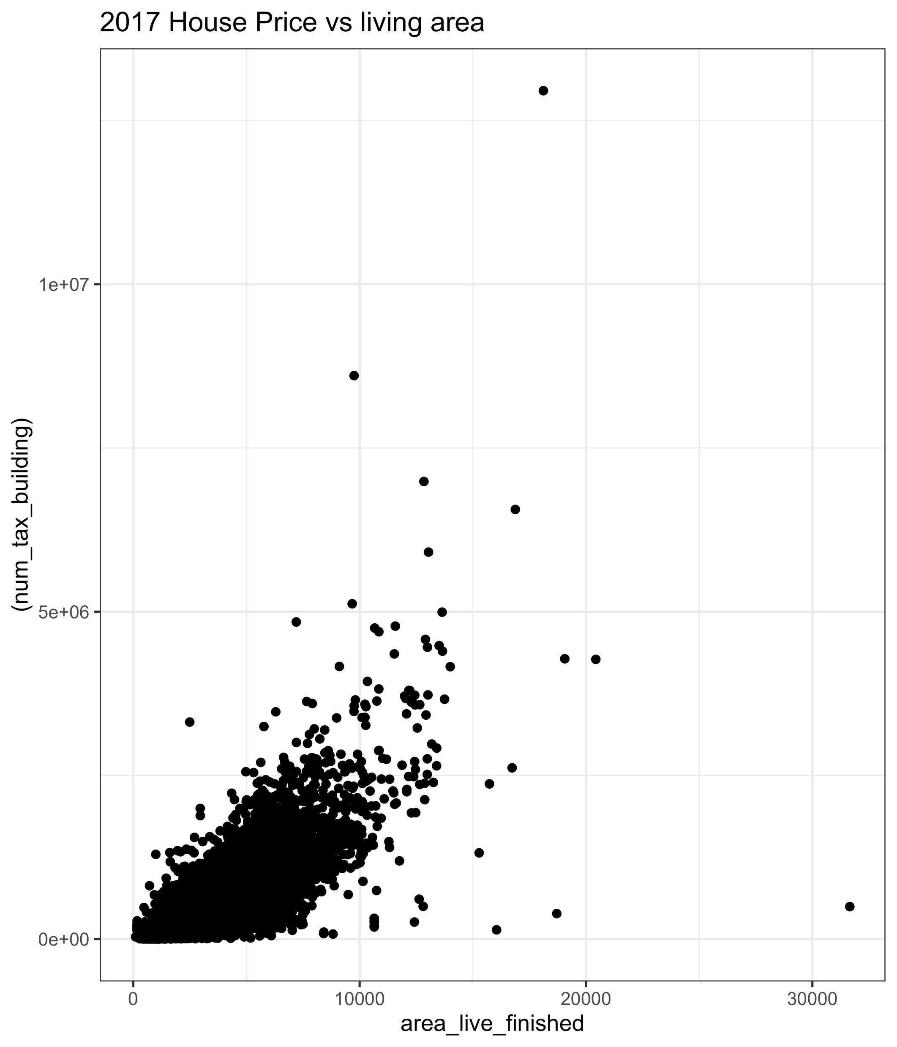
How did we specify our Hedonic Regression Model
3. Hedonic Regression
$$\log\left(House Price\right)=$$
$β_{0}+β_{1}\log\left(Living Area\right)$+
$$β_{2}\log\left(Lot Area\right)+$$
$$β_{3}\log\left(Garage Area\right)+$$
$$β_{4}log\left(Age\right)+$$
$$β_{5}No. Bedrooms+$$
$$β_{6}No. Bathrooms+$$
$$β_{7}No. Story+$$
$$β_{8}No. Garage+$$
$$β_{9}No. Pool+$$
$$β_{11}D\left(Fireplace\right)+$$
$$β_{12}D(Tub or Spa)$$

Slide 10
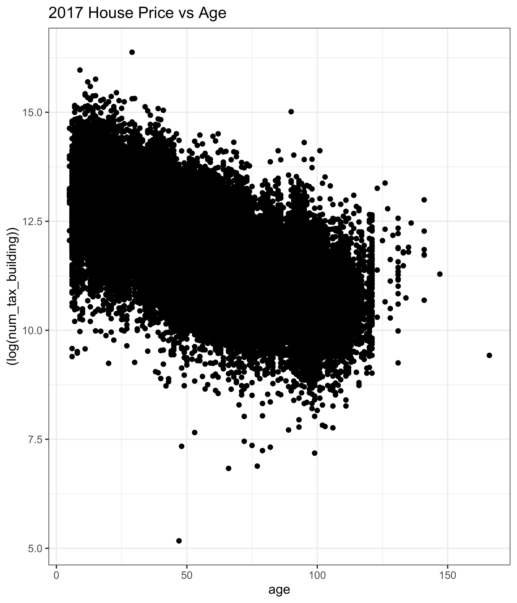
How did we specify our Hedonic Regression Model
3. Hedonic Regression
$$\log\left(House Price\right)=$$
$β_{0}+β_{1}\log\left(Living Area\right)$+
$$β_{2}\log\left(Lot Area\right)+$$
$$β_{3}\log\left(Garage Area\right)+$$
$$β_{4}log\left(Age\right)+$$
$$β_{5}No. Bedrooms+$$
$$β_{6}No. Bathrooms+$$
$$β_{7}No. Story+$$
$$β_{8}No. Garage+$$
$$β_{9}No. Pool+$$
$$β_{11}D\left(Fireplace\right)+$$
$$β_{12}D(Tub or Spa)$$

Slide 11
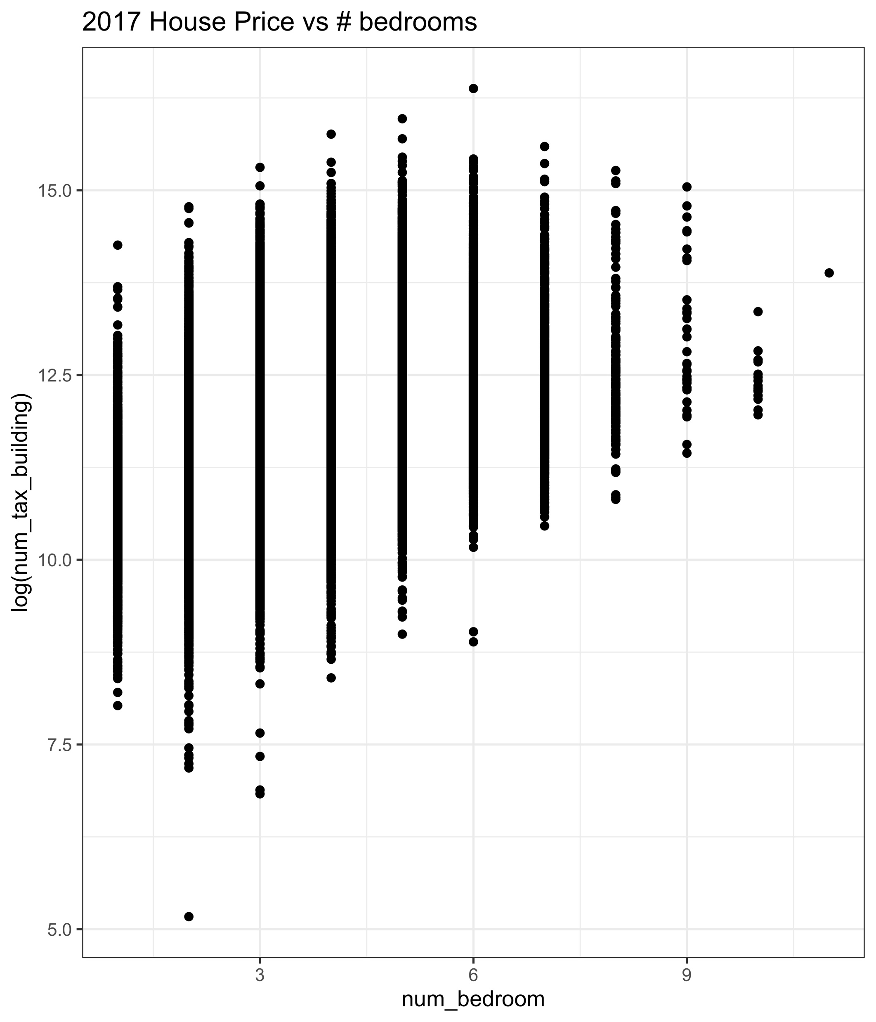
How did we specify our Hedonic Regression Model
3. Hedonic Regression
$$\log\left(House Price\right)=$$
$β_{0}+β_{1}\log\left(Living Area\right)$+
$$β_{2}\log\left(Lot Area\right)+$$
$$β_{3}\log\left(Garage Area\right)+$$
$$β_{4}log\left(Age\right)+$$
$$β_{5}No. Bedrooms+$$
$$β_{6}No. Bathrooms+$$
$$β_{7}No. Story+$$
$$β_{8}No. Garage+$$
$$β_{9}No. Pool+$$
$$β_{11}D\left(Fireplace\right)+$$
$$β_{12}D(Tub or Spa)$$

Slide 12
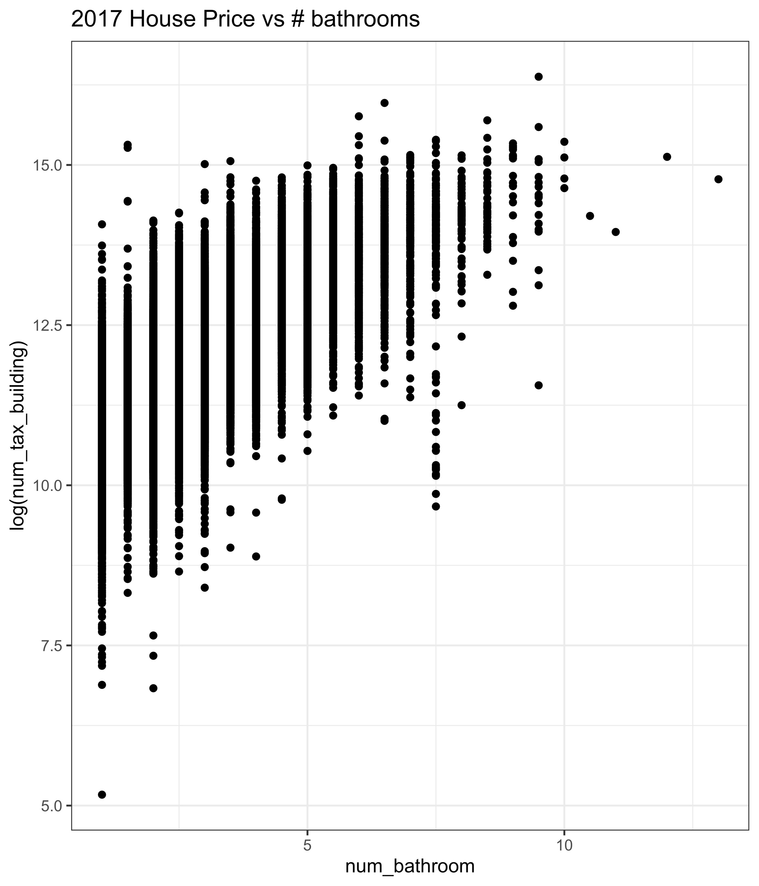
How did we specify our Hedonic Regression Model
3. Hedonic Regression
$$\log\left(House Price\right)=$$
$β_{0}+β_{1}\log\left(Living Area\right)$+
$$β_{2}\log\left(Lot Area\right)+$$
$$β_{3}\log\left(Garage Area\right)+$$
$$β_{4}log\left(Age\right)+$$
$$β_{5}No. Bedrooms+$$
$$β_{6}No. Bathrooms+$$
$$β_{7}No. Story+$$
$$β_{8}No. Garage+$$
$$β_{9}No. Pool+$$
$$β_{11}D\left(Fireplace\right)+$$
$$β_{12}D(Tub or Spa)$$

Slide 13
How did we specify our Hedonic Regression Model
3. Hedonic Regression
$$\log\left(House Price\right)=$$
$β_{0}+β_{1}\log\left(Living Area\right)$+
$$β_{2}\log\left(Lot Area\right)+$$
$$β_{3}\log\left(Garage Area\right)+$$
$$β_{4}log\left(Age\right)+$$
$$β_{5}No. Bedrooms+$$
$$β_{6}No. Bathrooms+$$
$$β_{7}No. Story+$$
$$β_{8}No. Garage+$$
$$β_{9}No. Pool+$$
$$β_{11}D\left(Fireplace\right)+$$
$$β_{12}D(Tub or Spa)$$
What are those?
Essentially all Dummy Variables (incl. No. Pools, because
there were only values of 0,1

Slide 14
The linear regression reports an adj. R² of 65%
3. Hedonic Regression
 | 2016 |  | 2017
Variables | Estimate | Std. Error† | Estimate | Std. Error†
Intercept | 7.078 *** | 0.024 | 6.811 *** | 0.024
log Living Area | 0.891 *** | 0.003 | 0.905 *** | 0.003
log Lot Area | 0.062 *** | 0.001 | 0.063 *** | 0.001
log Garage Area | 0.115 *** | 0.006 | 0.112 | 0.006
log Age | -0.699 *** | 0.002 | -0.652 *** | 0.002
No. Bedrooms | -0.057 *** | 0.001 | -0.061 *** | 0.001
No. Bathrooms | 0.107 *** | 0.001 | 0.109 *** | 0.001
No. Story | -0.028 *** | 0.001 | -0.028 *** | 0.001
No. Garage | 0.002 | 0.003 | 0.001 | 0.003
No. Pools | 0.109 *** | 0.001 | 0.105 *** | 0.001
Dummy Fireplace | 0.012 * | 0.005 | 0.012 * | 0.005
Dummy Tub or Spa | 0.096 *** | 0.002 | 0.094 *** | 0.002
N | 562983 |  | 563973
Breusch-Pagan Test | 16745 *** |  | 16765***
Adj. R | 0.6592 |  | 0.6551
*** p < 0.001; ** p < 0.01; * p < 0.05; †Robust Standard Errors

Slide 15
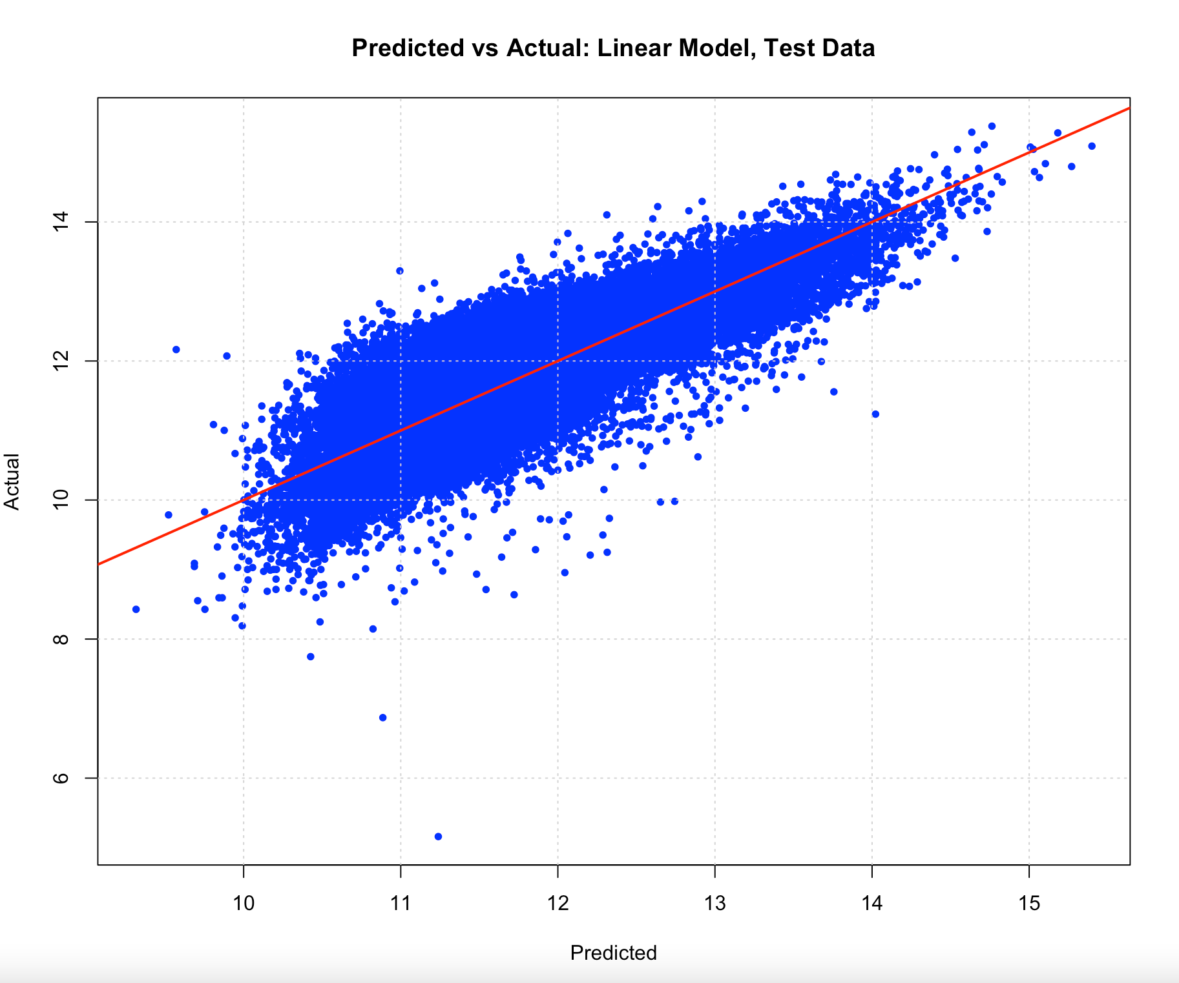
The linear regression reports an adj. R² of 65%
3. Hedonic Regression
Exemplary house
1500sqft living area
5000sqft lot area
300sqft garage area
30 years of age
5 bedrooms
2 bathrooms
2 stories
1 garage
1 pool
1 fireplace
1 spa
Estimated price of 266,370.47 USD

Slide 16
We have chosen tree-based models for machine learning
4. Machine Learning Algorithms
1
Bagging
Data Set
Subsample 1
Subsample 2
Subsample 3
2
Random Forest
X4 < d
X2 < d
X1 < d
X5 < e
X1 < f
X5 < e
X1 < f
X5 < e
X1 < f
3
XGBoost
$30
$42
$15
$50
$30
$42
$15
$50
$30
$42
$15
$50
4
Stacked Generalization
Prediction 1
Prediction 2
Prediction 3
Final Prediction
Notes:
All three work similarly:
Bootstrap sampling of the data
Tree building
Bootstrap aggregation for the final prediction
Benefits:
Work well with non-parametric data and highly dimensional
Feature Importance can be plotted, needed for inference
Strong results shown in data science competitions, in particular RF & XGB
Quick computation in comparison with neural networks
Disadvantages:
Parameters to be tuned individually to find optimal predictions
Tuning is computationally intense with large datasets and grid sizes

Slide 17
Ensemble combines the strengths of multiple variables
4. Machine Learning Algorithms
1
Bagging
Train
Test
Test
2
Random Forest
Test algorithm on
out-of-sample dataset
Algorithm 1
Algorithm 2
Algorithm 1
Algorithm 2
n-folds CV
3
XGBoost
4
Stacked Generalization
nrow x n-fold
output
Algorithm 3
Final
Prediction
Use as input for training
(incl. dependent variable)
Notes:
Stacked Generalization is a meta-ensemble method
Ensemble meaning that it combines several machine learning techniques into one predictive model
Ensemble should by theory be as good, or better than the used algorithms.
We used Bagging, RF, XGB as Algorithms in the base layer and linear regression to find the optimal allocation of each model

Slide 18
Ensemble Model shows best performance for testing data
4. Machine Learning Results
 | Root Mean Square Error |  | Adjusted R²
 | Train | Test | Train | Test | ø Prediction Error | p-value
Linear Regression | 0.4010 | 0.4001 | 0.6587 | 0.6607 | -0.00051 | 0.632
Bagging | 0.3785 | 0.3788 | 0.6963 | 0.6953 | 0.00088 | 0.385
Random Forest | 0.2688 | 0.3600 | 0.8467 | 0.7254 | -0.00345 | 0.0003 ***
XGBoost | 0.3238 | 0.3572 | 0.7776 | 0.7296 | -0.00087 | 0.358
Stacked Generalization | 0.3113 | 0.3529 | 0.7945 | 0.7361 | -0.00218 | 0.02 **
Notes:
Outperformance of testing dataset:
Linear Model underperforms any other ML Model – led by Stacked Generalization with a difference of 11.4%.
Around 10% better than Linear Regression
Difference between Train and Test:
Large with Random Forest
Prediction error
the t-test of the prediction error shows that on the 5% significance level the Null-Hypothesis of having a zero mean in the average prediction error (actual minus predicted value) can be rejected

Slide 19
Tree-based ML methods report similar feature importances
4. Machine Learning Results
 | Linear Model | Bagging | Random Forest | XGBoost
Measurement Method | Part* | Frequency** | Permutation*** | Gain****
Top 1 | Living Area | Living Area | Living Area | Living Area
Top 2 | No. Bathrooms | Age | Age | Age
Top 3 | No. Pool | No. Bathroom | No. Bathroom | Area Garage
Top 4 | Lot Area | No. Story | Area Lot | Area Lot
Top 5 | Dummy Tub or Spa | Area Lot | No. Bedroom | No. Bathroom
*Part: measures the unique contribution of independent variables to R²
**Frequency: measures the frequency of a feature across all trees.
***Permutation: measures the decrease in a model score when a single feature value is randomly shuffled, which breaks the relationship between the feature and the true outcome.
****Gain: represents the fractional contribution of each feature to the model based on the total gain of this feature’s splits.
Notes:
All ML methods have similar results, in particular for first 2
Area Garage is relatively more important for XGBoost
Bathroom is more important than Bedroom
This can also help to select the most important variables in analysis

Slide 20
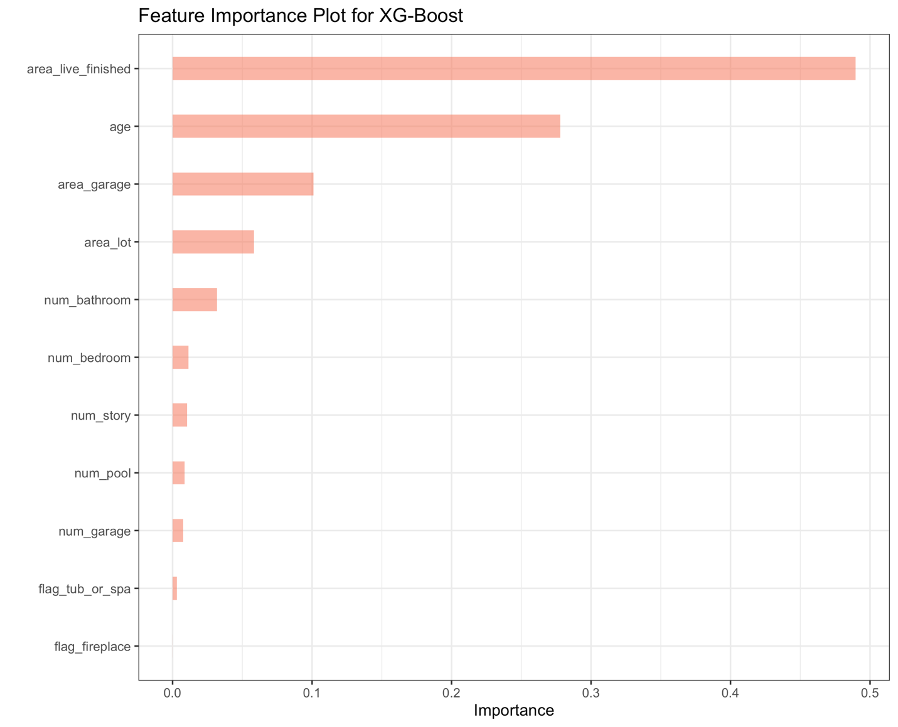
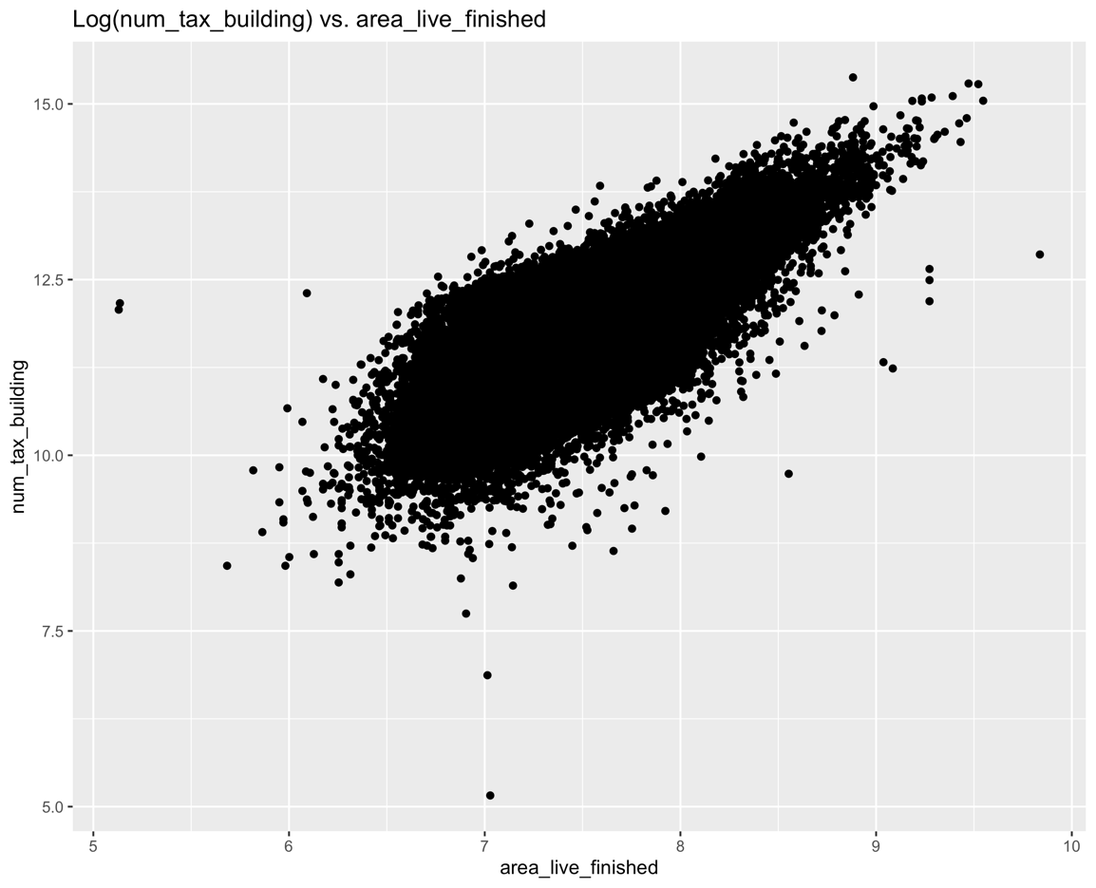
Living Area is the most important variable for XG-Boost
4. Machine Learning Results
Notes:
Importance metric = improvement in prediction brought by bringing the feature on a variable (so it is related to frequency but not the same)
We can see how much «Living Area» is more important than all other variables
The same goes for «Age»

Slide 21
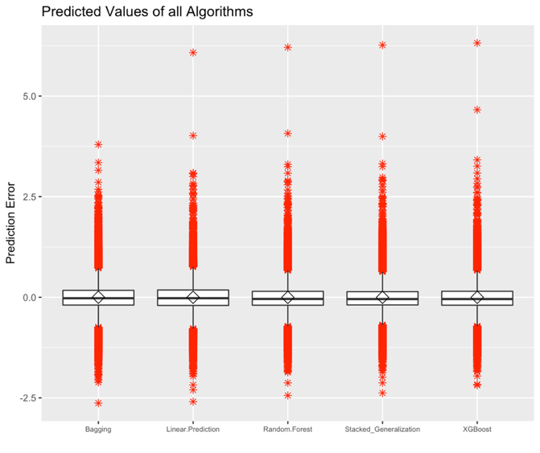
The algorithms still contain many outliers
5. Interpretation of Results
Notes:
There are many outliers in red
Where does the problem lie?

Slide 22
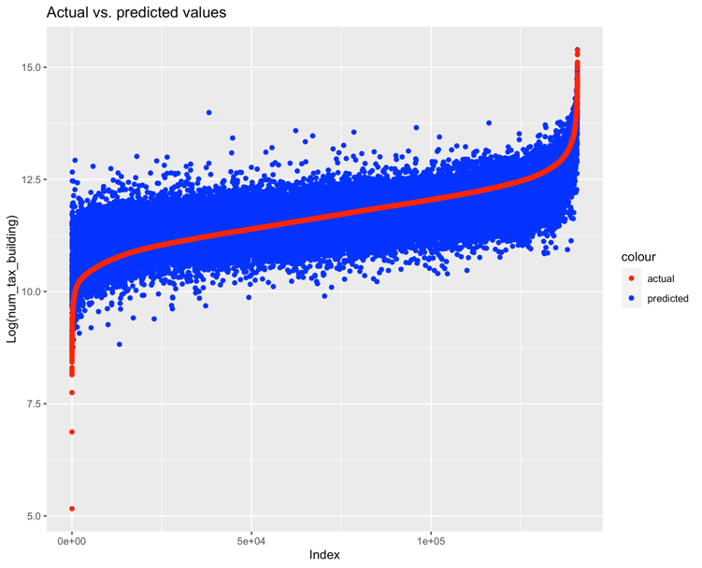
All of the algorithms perfom poorly on extreme values
5. Interpretation of Results
XGBOOST
STACKED GENERALIZATION
Notes:
The actual values are sorted accending
Either we build a seperate model for the extreme values
Or be even stricter in data cleaning of outliers

Slide 23
ML methods show significant out-of-sample outperformance
6. Conclusion
Hedonic regression can explain substantially the variance of the data, supporting hedonic pricing theory
ML Methods complement Hedonic Regression for economic analysis, but outperform solely on prediction tasks
Variable Importance plots help to determine the selection of Hedonics
XGBoost is the most favorable algorithm considering the prediction variance and computational speed
Stacked Generalization performs slightly better as XGBoost with higher variance
Overfitting can be (partly) mitigated with regularization techniques
Transfering results to other geographies (e.g. countries in Europe)
Consider the spatial effect and combine with ML methods
Testing with data from other sources
Using multiple years to see changes in variable importances
Notes:
There is little research combining ML research with spatial effects

Slide 24



Comparative Analysis of Machine Learning-Based Valuation Models for Predicting Residential Real Estate Prices
Real Estate Finance Research Seminar
Kilian Gerding
Tim Graf
Los Angeles City

